Slide 1
Thyroid disorders
Dr Anjumanara Omar

Slide 2
OUTLINE
Thyroid Physiology
Pathophysiology
Hypothyroidism
Hyperthyroidism
Summary

Slide 3
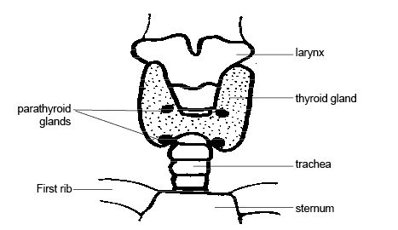
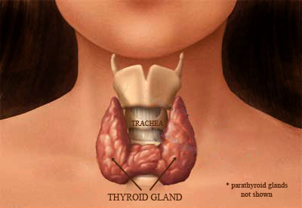
LOCATION OF THE THYROID GLAND

Slide 4
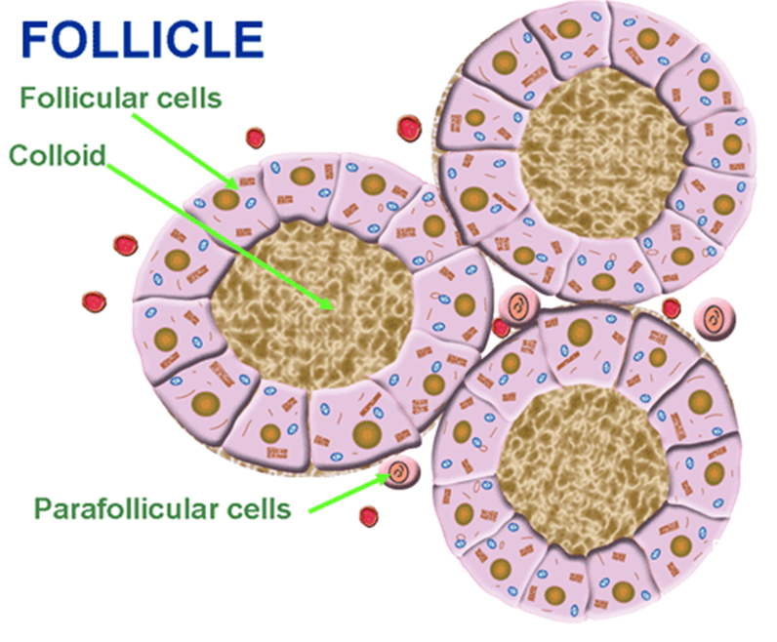
THYROID GLAND
The thyroid gland
consists of 2 types of
cells:
Follicular cells: These are more abundant, and the major secretory cells. They secrete Thyroid hormone.
Parafollicular cells or C-cells: These are fewer in number & interspersed. They secrete Calcitonin.
Notes:
These 2 secretory cells are derived embryologically from 2 different sources: Follicular cells from endoderm of primitive pharynx & C-cells from neuroectoderm.

Slide 5
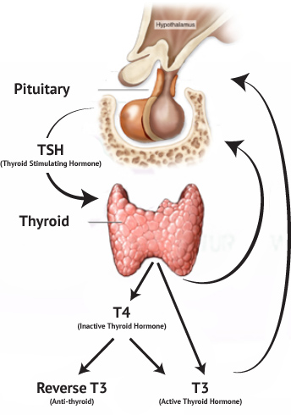
Physiology

Slide 6
THYROID HORMONES
Uptake of iodide by follicular cells
Oxidation of iodide to iodotyrosine (TPO)
Formation of iodothyronins from iodotyrosine (TPO)
Proteolysis of thyroglobulin to T4 and T3 (lysosomal proteolysis)
Conversion of T4 to T3 in periphery (deiodinases)

Slide 7
T4 major hormone produced by thyroid gland
T3 is active form of TH
Thyroid hormone carried by TBG,thyroxine binding prealbumin (TBPA) and albumin
T3 has lower affinity for binding protein than T4
Free thyroid hormone not bound to protein is active form
T3 more potent in peripheral tissues

Slide 8
HYPOTHYROIDISM
Inadequacy of thyroid hormone in the body

Slide 9
Classifications
Primary Hypothyroidism
Secondary Hypothyroidism
Tertiary Hypothyroidism

Slide 10
Primary Hypothyroidism
Congenital
Acquired

Slide 11
Congenital
Thyroid dysgenesis/agenesis
Inborn error of thyroxin synthesis (dyshormonogenesis)
Maternal antibody mediated hypothyroidism

Slide 12
Acquired
Hashimotos thyroiditis (common)
Iodine deficiency
Drug induced thyroiditis
Irradiation of thyroid gland
Surgical excision

Slide 13
Symptoms in newborn
Constipation
Prolonged jaundice
Hypothermia
Poor feeding
Hypotonia
Cyanosis
Hoarse cry
Umblical hernia
Macroglossia

Slide 14
Symptoms in children
Goiter
Short stature
Declining school performance
Cold intolerance
Fatigue
Dry Skin
Constipation
Weight gain
Bradycardia
Depression

Slide 15
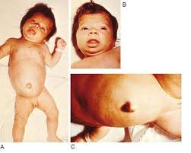

Slide 16
Investigations
TSH (↑)
FT4 (↓)
Serum antithyroid antibody
Radioisotope thyroid imaging

Slide 17
Treatment
Levthyroxine 10-15 mic/kg day
Titrate dose according to levels of TSH and FT4

Slide 18
Secondary Hypothyroidism
Failure of adequate TSH to stimulate thyroid glands
FT4 low
TSH normal or low
Not very common in children

Slide 19
Causes
Pituitary agenesis
Genetic defects
Pituitary tumours
Head travma or irradiation

Slide 20
Complications of hypothyroidism
Mental retardation
Short stature
Slowed metabolism
Obesity
Impaired memory

Slide 21
Hyperthyroidism
Excessive production of thyroid hormones causing accelerated metabolism in the peripheral tissue

Slide 22
Hyperthyroidism
Graves Disease
Rare in children but increases during puberty
Female:Male ratio (5:1)
Neonatal Graves
Transpalcental antibodies
TSH receptor mutation
Subacute thyroiditis
Exogenous thyroxine Exposure

Slide 23
Signs and Symptoms
Change in school performance
Insomnia
Restlessness and irritability
Weight loss
Tachycardia
Diarrhea
Tremor
Heat intolerance

Slide 24
Graves Disease
Hyperthyroidism
Ophthalmopathy
Dermopathy

Slide 25
Caused by Thyroid Stimulating Antibodies (TSI)
Bind to TSH receptor,activate causing follicular growth and release thyroid hormones
Most likely infection triggers

Slide 26
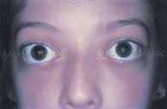

Slide 27
Investigations
Low TSH
High FT4 and FT3
Positive thyroid stimulating antibodies
-Thyroid peroxidase
-Thyroglobulin
-Thyroid Stimulating Immunoglobulin

Slide 28
Treatment
Radioactive iodine
Thionamides (Methimazole,PTU)
Surgical excision

Slide 29
Colloid Goiter (Non toxic)
Diffuse enlargement of thyroid gland
TFT normal
Positive family history
Maybe associated with Nodular goiter as adults
Therapy not indicated

Slide 30
Thyroid Nodules
Rare in children
Higher incidence of malignancy
Evaluation
Thyroid US
Fine needle aspiration
Biopsy

Slide 31
Thyroid cancers
Carcinoma rare (1.5% in kids >15yrs)
Papillary carcinoma 85-90%
Medullary carcinoma 5%
Follicular and anaplastic Ca

Slide 32
ANY QUESTIONS

